Slide 1
Proper Source Selection
And Other Source Considerations

Slide 2
Reviewing: Mind-mapping Lenses and Perspectives
Possible perspectives to explore
It is the role of the media to expose any corrupting influence of financial contributors.
There is already a significant amount of legislation in place to protect against excessive influence of financial contributors.
We cannot call our society democratic unless people have equal say.
Possible perspectives to explore
Corporations with most money will exercise more control over elected governments in future. They will effectively have control over politicians.
Money talks! Changes in regulation or legislation will make no difference – those that want to will always find a way to donate the money.
Limit on campaign contributions will limit the expression of new ideas about governing societies.
Futuristic
Cultural & Social
Possible perspectives to explore
Visual representations of politicians as corrupt are prevalent in 21st. Century.
We have come to accept the influence of the wealthy in politics as normal.
Should there be a limit on financial contributions to political parties?
Possible perspectives to explore
Environmental organizations are unlikely to have the same money to contribute to politicians as mining and oil companies – it is unjust that the latter should have more influence.
Artistic & Philosophical
Environmental
Possible perspectives to explore
The wealthy have a right to do what they want with it (including give it to political parties).
Everyone should have equal influence on what is prioritized by politicians – a financial limit would reduce the influence of any group or individual.
Possible perspectives to explore
Corporations that donate to parties only have money to donate because people chose to buy their products/services.
Political parties need to get their money from somewhere.
Ethical
Economic
Political & Historical
Scientific
Possible perspectives to explore
Law governing contribution to political parties should change with time and place.
Politicians must be held to account for the decisions they make. Undue influence can only be detected if there is transparency in who has contributed money.
Campaign contributions limit the freedom to conduct scientific research by politicizing an academic process.
[Example provided by College Board]

Slide 3
Dimensions of Disciplinary Understanding
1
Deciding what to look for in academic sources...
See post in Google Classroom!

Slide 4
Proper Sources (By Medium)
Digital Databases
Web Sources
Print Sources
Academic, peer reviewed sources; relevant, current (depending on topic); attributable, with full citations and works cited/bibliographic info (search using abstracts)
“Primary sources”- government websites, legal language, contracts, studies, census publications, public libraries, university websites, etc.
Relevant books; artistic if doing something in literary or artistic interpretation (primary source); deep analyses, anthologies, etc. in expository work (secondary source)
Notes:
When available, academic and peer-reviewed publications, scholarly monographs, and textbooks are usually the most reliable sources. However, some scholarly material may be outdated, in competition with alternate theories, or controversial within the relevant field. Try to cite present scholarly consensus when available, recognizing that this is often absent. Reliable non-academic sources may also be used in articles about scholarly issues, particularly material from high-quality mainstream publications. Deciding which sources are appropriate depends on context. Material should be attributed in-text where sources disagree.
Typically, many online resources that come from scholarly sources are good places to get information. For example, through many public and university libraries, people can gain access to sites that often have:
Letters
Diaries
First-person accounts
Newspaper archives (Such as the Washington Post or New York Times Archives)
Along with that, people and places’ official sites are often legitimate sources if they contain new or useful information pertinent to the topic being researched. For instance, if one was researching President Gerald Ford, going to his museum's website would be a good place to get some information on him and where he grew up.
Books on the topic are great for research. They often contain indexes that determine whether or not they will be useful without having to read the entire text. Historical texts, biographies and scholarly studies are often available at public libraries. Asking the library staff for help finding a particular item should never be a problem, either. Finding historical documents or using the online system should be something the librarians are more than willing to help students access.

Slide 5
Per The LEAF Project:
Questionable sources are those with a poor reputation for checking the facts, or with no editorial oversight. Such sources include websites and publications expressing views that are widely acknowledged as extremist, or promotional in nature, or which rely heavily on rumors and personal opinions. Questionable sources are generally unsuitable for citing contentious claims about third parties, which includes claims against institutions, persons living or dead, as well as more ill-defined entities. The proper uses of a questionable source are very limited.

Slide 6
Words of Caution
Can’t find a publication date?
Author(s)? Revision date?
Publication team or process?
Skip it...

Slide 7
Scholarly vs. Popular Sources
Scholarly
Written by experts
Research based
Peer-reviewed (refereed)
Cite sources (bibliography, footnotes, etc.)
Published in scholarly journals
Examples: Journal of Clinical Psychology, The New England Journal of Medicine
Popular
Written by journalist
Do not have formal citations
Published in popular magazines, journals
Lots of images and advertisements
Examples: Time, Newsweek, National Geographic
Per College Board resources

Slide 8
Self-published Sources...
E-books, newsletters, wikis, blogs, personal websites, social media sites/videos, tweets…
Depends on your plan. Analyzing these? Cool. Using as support? Eh.
Notes:
Anyone can create a website or pay to have book published, then claim to be an expert in a certain field. For that reason self-published media—whether books, newsletters, personal websites, open wikis, blogs, personal pages on social networking sites, Internet forum postings, or tweets, —are largely not acceptable. This includes any website whose content is largely user-generated, including the Internet Movie Database, Cracked.com, CBDB.com, and so forth, with the exception of material on such sites that is labeled as originating from credentialed members of the sites' editorial staff, rather than users.
"Blogs" in this context refers to personal and group blogs. Some news outlets host interactive columns they call blogs, and these may be acceptable as sources so long as the writers are professional journalists or are professionals in the field on which they write and the blog is subject to the news outlet's full editorial control. Posts left by readers may never be used as sources.
Self-published material may be acceptable when produced by an established expert on the topic of the article whose work in the relevant field has previously been published by reliable third-party publications. Self-published sources should never be used as third-party sources about living persons, even if the author is a well-known professional researcher or writer.

Slide 9
Assessing if something is Usable, or just Topic-Inspiration
Careful reading = skeptical reading
Avoid trivial mistakes
Double-check ALL sources, source authors, source publishers—find bias
(if you use dubious evidence, purposefully, address that it may be problematic; this builds ethos)
Must be
sufficient
Must be
precise & accurate
Avoid “hedging” claims
Avoid superlatives, or empty comparisons
Margin of error depends on the field
Word choice is super important
Evidence has
to satisfy the following:
General error is too little evidence
Think about the full range of variation/availability
Small sample sizes are generally problematic (must be acknowledged explicitly)
Avoid “cherry-picking” and the anecdotal
Must be
representative
(collectively,
holistically)
Must be
authoritative
See what other researchers are valuing or devaluing (this means a breadth of research, and pay attention to their citations and the neg/pos of those works)
Pay attention to ‘failed arguments’ (what NOT to do)
Think about ‘degrees of authority’ on an issue

Slide 10
Best way to use sources? Find the threaded conversations-see their works cited!
(works on Wiki too!)

Slide 11
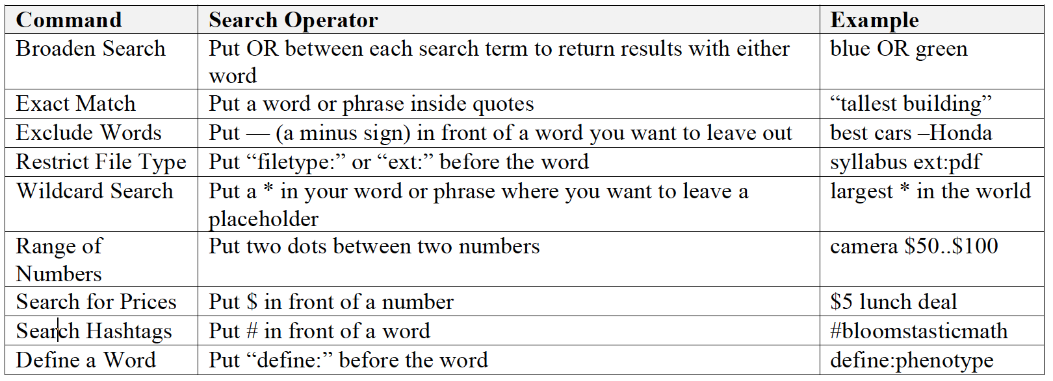
Searching via Databases or Search Engines
Per College Board resources

Slide 12
Today’s Task: Practicing Some Legitimate Source Evaluation
2
Setting up extended Annotated Bibliographies
(to be continued)

Slide 13
What is an Annotated Bibliography?
A bibliography is a list of sources (books, journals, websites, periodicals, etc.) one has used for researching a topic. Bibliographies are sometimes called "references" or "works cited" depending on the style format you are using. A bibliography usually just includes the bibliographic information (i.e., the author, title, publisher, etc.).
An annotation is a summary and/or evaluation.
Therefore, an annotated bibliography includes a summary and/or evaluation of each of the listed sources.
Per THE Purdue Writing Lab

Slide 14
First Sources: Web and Scholarly Journal
(Find one of each and evaluate as below):
Find a web resource on a search engine:
Who is responsible for creating this website?
When was the website created? When was the page last updated?
What are the strengths of the website?
How even-handed is it? Does it have any potential for bias?
Who is the intended audience?
What is the primary focus?
What evidence is provided for the claims?
Find a research study on JSTOR or Google Scholar:
What are the explicit or implied objectives of the study?
What methods are used in the study? (Summarize the procedures)
What are the important ideas/findings?
What is a limitation of the study?
What is a significant implication of the study?
What conclusions are presented?
Notes:
Anyone can create a website or pay to have book published, then claim to be an expert in a certain field. For that reason self-published media—whether books, newsletters, personal websites, open wikis, blogs, personal pages on social networking sites, Internet forum postings, or tweets, —are largely not acceptable. This includes any website whose content is largely user-generated, including the Internet Movie Database, Cracked.com, CBDB.com, and so forth, with the exception of material on such sites that is labeled as originating from credentialed members of the sites' editorial staff, rather than users.
"Blogs" in this context refers to personal and group blogs. Some news outlets host interactive columns they call blogs, and these may be acceptable as sources so long as the writers are professional journalists or are professionals in the field on which they write and the blog is subject to the news outlet's full editorial control. Posts left by readers may never be used as sources.
Self-published material may be acceptable when produced by an established expert on the topic of the article whose work in the relevant field has previously been published by reliable third-party publications. Self-published sources should never be used as third-party sources about living persons, even if the author is a well-known professional researcher or writer.

Slide 15
Next Up: Identifying the Argument-Argument Mapping/Diagramming

